Slide 1
Advanced Web Technology(CS163) Class
On
Adding Behavior to Objects, objects, Class, Properties and Methods, Class Expressions and Hoisting, Exports and Imports declaration
Dr. Harjeet Singh
Department of Computer Science and Engineering
Chitkara University, Punjab

Slide 2
Objects
An object is a collection of properties, and a property is an association between a name (or key) and a value.
A property's value can be a function, in which case the property is known as a method.
In JavaScript, an object is a standalone entity, with properties and type.
Compare it with a cup, for example. A cup is an object, with properties. A cup has a color, a design, weight, a material it is made of, etc.
The same way, JavaScript objects can have properties, which define their characteristics.

Slide 3
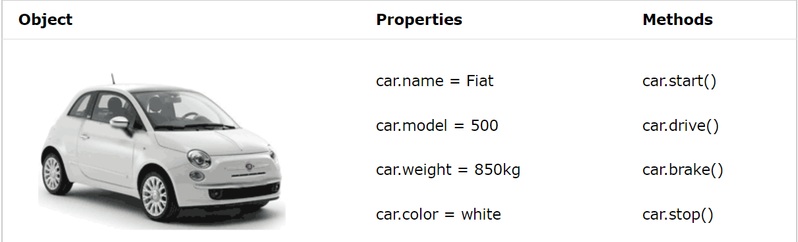
Real Life Objects, Properties, and Methods

Slide 4
Javascript object Example 1
<!DOCTYPE html>
<html>
<body>
<h2>JavaScript Variables</h2>
<p id="demo"></p>
<script>
// Create and display a variable:
let car = "Fiat";
document.getElementById("demo").innerHTML = car;
</script>
</body>
</html>

Slide 5
Javascript object Example 2
<!DOCTYPE html>
<html>
<body>
<h2>JavaScript Objects</h2>
<p id="demo"></p>
<script>
// Create an object:
const car = {type:"Fiat", model:"500", color:"white"};
// Display some data from the object:
document.getElementById("demo").innerHTML = "The car type is " + car.type;
</script>
</body>
</html>

Slide 6
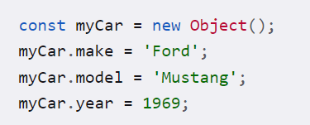
Object and it’s properties
A JavaScript object has properties associated with it.
A property of an object can be explained as a variable that is attached to the object.
Object properties are basically the same as ordinary JavaScript variables, except for the attachment to objects.
The properties of an object define the characteristics of the object.
You access the properties of an object with a simple dot-notation:
objectName.propertyName

Slide 7
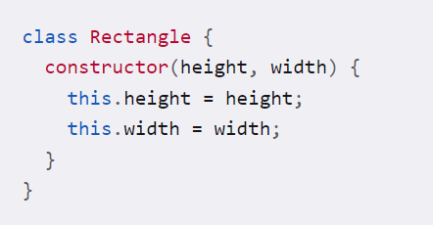
Classes
Classes are in fact "special functions", and just as you can define function expressions and function declarations, the class syntax has two components: class expressions and class declarations.
Class Declaration:
One way to define a class is using a class declaration. To declare a class, you use the class keyword with the name of the class ("Rectangle" here).

Slide 8
Class Hoisting
An important difference between function declarations and class declarations is that while functions can be called in code that appears before they are defined, classes must be defined before they can be constructed. Code like the following will throw a ReferenceError
const p = new Rectangle(); // ReferenceError
class Rectangle {}
This occurs because while the class is hoisted, its values are not initialized.

Slide 9
Class expressions
A class expression is another way to define a class. Class expressions can be named or unnamed. The name given to a named class expression is local to the class's body. However, it can be accessed via the name property.

Slide 10
Class expressions Example
// unnamed
let Rectangle = class {
constructor(height, width)
{ this.height = height; this.width = width;
} };
console.log(Rectangle.name);
// output: "Rectangle"
// named
let Rectangle = class Rectangle2
{
constructor(height, width)
{
this.height = height; this.width = width;
} };
console.log(Rectangle.name); // output: "Rectangle2"

Slide 11
Class Methods
Class methods are created with the same syntax as object methods.
Use the keyword “class” to create a class.
Always add a constructor() method.
Then add any number of methods.
Example:
class ClassName { constructor() { ... } method_1() { ... } method_2() { ... } method_3() { ... } }

Slide 12
Example of class methods
class Car { constructor(name, year) { this.name = name; this.year = year; } age() { let date = new Date(); return date.getFullYear() - this.year; } } let myCar = new Car("Ford", 2014); document.getElementById("demo").innerHTML = "My car is " + myCar.age() + " years old.";

Slide 13
Static methods and properties
The static keyword defines a static method or property for a class.
Static members (properties and methods) are called without instantiating their class and cannot be called through a class instance.
Static methods are often used to create utility functions for an application, whereas static properties are useful for caches, fixed-configuration, or any other data you don't need to be replicated across instances.

Slide 14
Example
class Point { constructor(x, y) {
this.x = x; this.y = y; }
static displayName = "Point";
static distance(a, b) {
const dx = a.x - b.x;
const dy = a.y - b.y;
return Math.hypot(dx, dy); } }
const p1 = new Point(5, 5);
const p2 = new Point(10, 10); p1.displayName;
p1.distance;
p2.displayName;
p2.distance;
console.log(Point.displayName);
console.log(Point.distance(p1, p2));
// 7.0710678118654755

Slide 15
Instance properties
Instance properties must be defined inside of class methods:
class Rectangle {
constructor(height, width)
{
this.height = height;
this.width = width;
}
}

Slide 16
Exports declaration
Export before declarations
We can label any declaration as exported by placing ‘export’ before it, be it a variable, function or a class.
For instance, here all exports are valid:
// export an array
export let months = ['Jan', 'Feb', 'Mar','Apr', 'Aug', 'Sep', 'Oct', 'Nov', 'Dec’];
// export a constant
export const MODULES_BECAME_STANDARD_YEAR = 2015; // export a class
export class User { constructor(name) { this.name = name; } }

Slide 17
Imports declaration
Usually, we put a list of what to import in curly braces import{-----} like this:
// 📁 main.js
import {sayHi, sayBye} from './say.js'; sayHi('John’); // Hello, John!
sayBye('John’);
// Bye, John!
But if there’s a lot to import, we can import everything as an object using import * as <obj> for instance:
// 📁 main.js
import * as say from './say.js'; say.sayHi('John’);
say.sayBye('John');

Slide 18
Import “as”
We can also use as to import under different names.
For instance, let’s import sayHi into the local variable hi for brevity, and import sayBye as Bye.
// 📁 main.js
import {sayHi as hi, sayBye as bye} from './say.js’;
hi('John'); // Hello, John!
bye('John'); // Bye, John!

Slide 19
Export “as”
The similar syntax exists for export.
Let’s export functions as hi and bye.
// 📁 say.js
...
export {sayHi as hi, sayBye as bye};
Now hi and bye are official names for outsiders, to be used in imports:
// 📁 main.js
import * as say from './say.js’;
say.hi('John'); // Hello, John!
say.bye('John'); // Bye, John!

